Slide 1
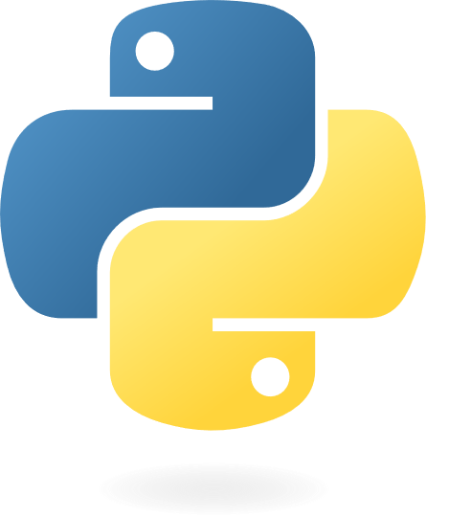
PROGRAMMING WITH PYTHON MINI-PROJECT PRESENTATION
WEB SCRAPING APPLICATION
PRESENTERS :-
YASH R. BALKHANDE
SHREYASH N. WAGHMARE
MOHIT V. GEDAM
ABOLI C. DESHMUKH
AACHAL V. GANVIR
GUIDE :- PROF. DR. A. D. RAUT

Slide 2
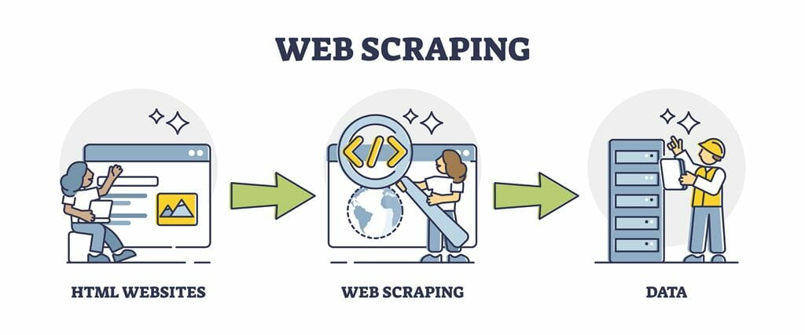
WHAT IS SCRAPING ?
Web Scrapping is a software technique of extracting information from websites.
It focuses on transformation of unstructured data on the web(typically HTML), into structured data that can be store & analyzed.

Slide 3
OBJECTIVES OF OUR PROJECT
Introduce the concept of structured data
This project aims to see any of the information or record regarding the recruiters
Discuss how data can be extracted from web pages
To developed an well designed database to store recruiters Information

Slide 4
WHY WE SCRAPE ?
Web pages contain wealth of information , designed mostly for human consumptions
Static Websites
Interfacing with third party with no API access
Websites are more important than API
The data is already available(in the form of web pages)
No rate limiting
Anonymous access

Slide 5
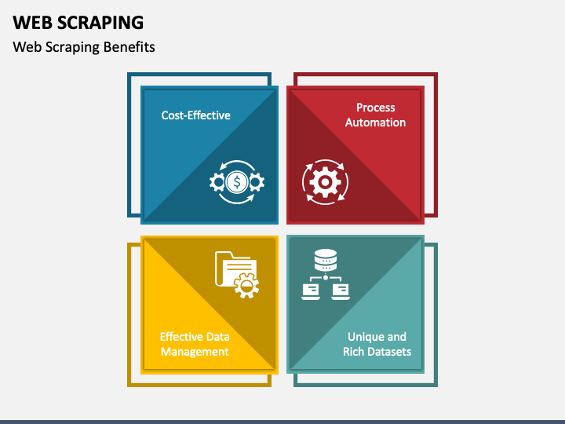

Slide 6

Tools and techniques for scraping
EXPRESS JS
EJS
MONGODB ATLAS
PYCHARM

Slide 7

ADVANTAGES OF SCRAPING
Automation
Real-time data
Access to otherwise difficult to obtain data
Cost-effective
Efficient data collection
Variety of uses

Slide 8
DISADVANTGES OF DATA SCRAPING
Outdated Information
Problems with Automation
Rare disadvantages Data Scraping are Speed & Protection Policies
Hard to Analyze
Require Programming Language

Slide 9
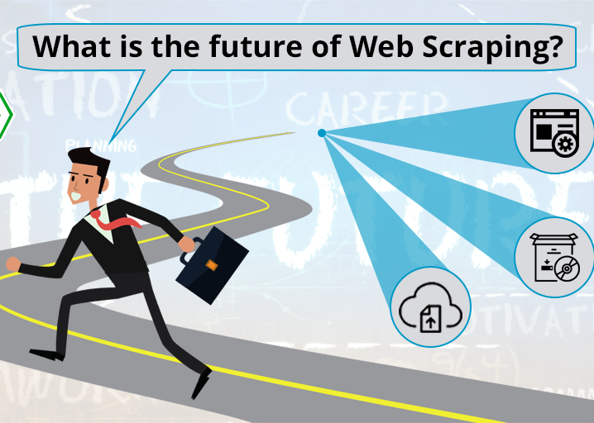
FUTURE SCOPE
Equity Research
Fast-forwarding Venture Capital Endeavours
Sentiment Analysis
Marketing
Way Forward

Slide 10
REFERENCES
Web Scraping (Wikipedia)
W3School
Tutorials Point Python
Getting Started Image Source
https://towardsdatascience.com/web-scraping-with-python-a-to-copy-z-277a445d64c7
https://data-lessons.github.io/library-webscraping-DEPRECATED/01-introduction/

Slide 11
THANK YOU!

